Slide 1
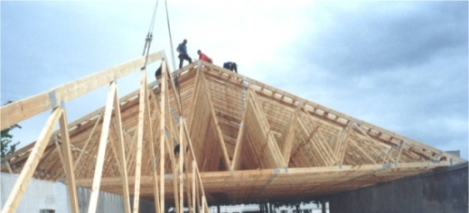
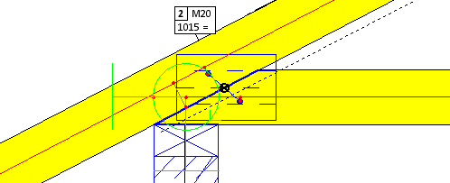
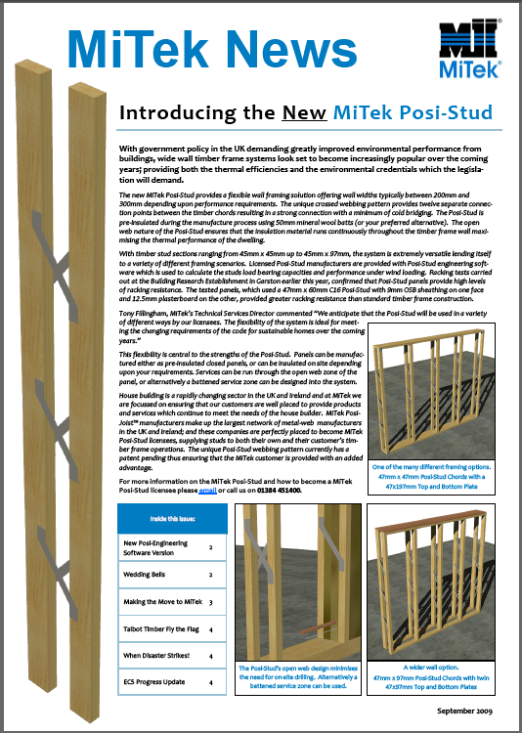
The MiTek Posi-Stud

Slide 2
The MiTek Posi-Stud – Thermal Performance

Slide 3
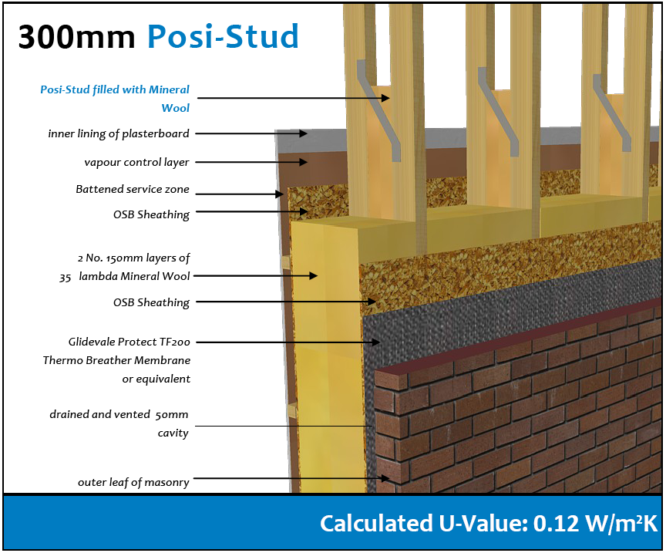
The MiTek Posi-Stud – Thermal Performance

Slide 4
Housing is Changing
U Value:
0.09 W/m²K
400mm
44l Roll
Notes:
400 mm – High Lambda Loft Rolls – 0.9 U-Value

Slide 5
The Posi X-Rafter

Slide 6
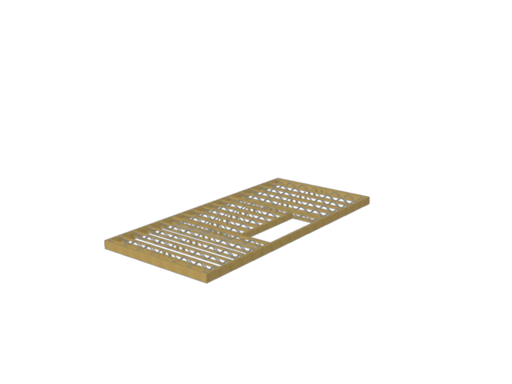
The MiTek Posi X-Rafter
The Posi-Joist cassette floor provides the opportunity to guarantee a totally accurate platform for the spandrel panels.

Slide 7
The MiTek Posi X-Rafter

Slide 8
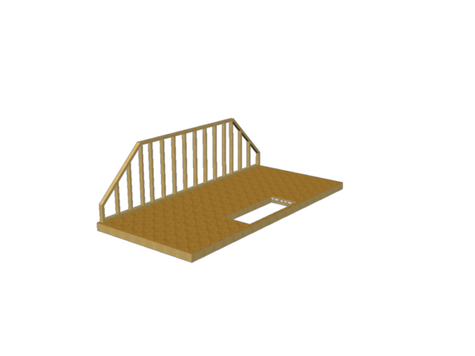
The MiTek Posi X-Rafter
The Posi X-Rafter system uses flat top spandrel panels to support a structural ceiling cassette

Slide 9
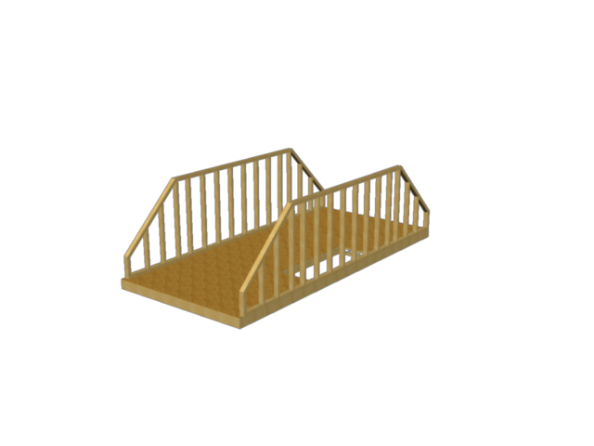
The MiTek Posi X-Rafter
The Posi X-Rafter system uses flat top spandrel panels to support a structural ceiling cassette

Slide 10
The MiTek Posi X-Rafter
Ceiling cassette spans between spandrel panels, incorporating the roof support purlins

Slide 11
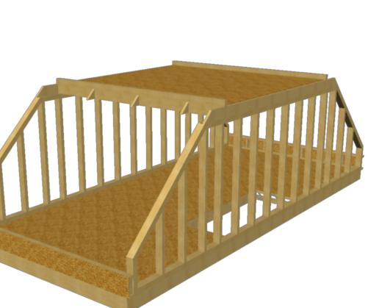
The MiTek Posi X-Rafter
The Posi X-Rafter panels are supported at the eaves on dwarf timber frame walls

Slide 12
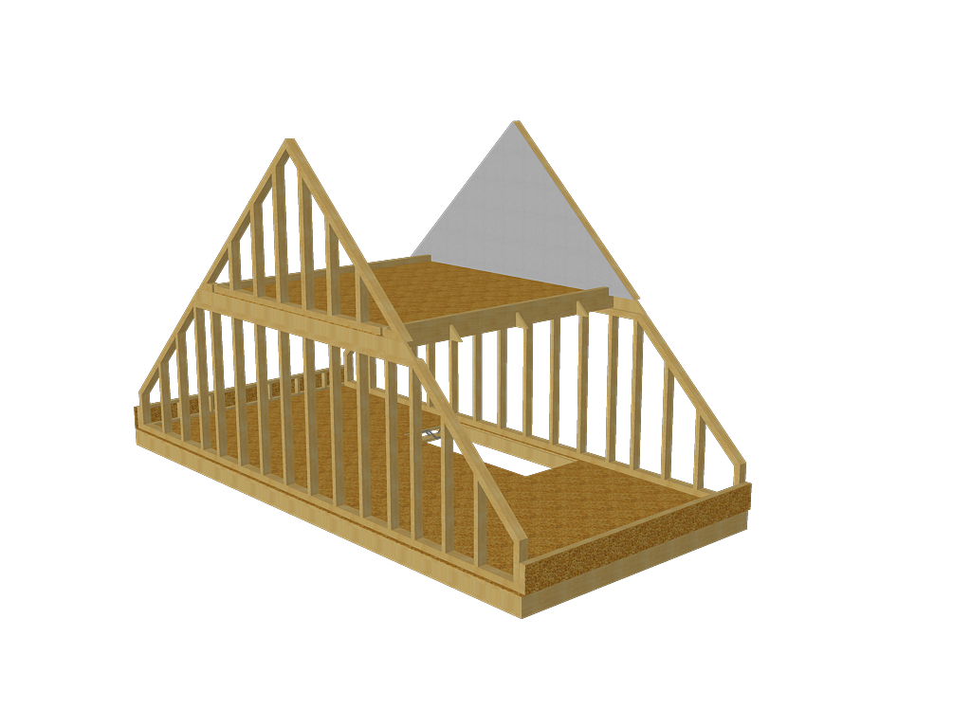
The MiTek Posi X-Rafter
Apex spandrels put in position

Slide 13
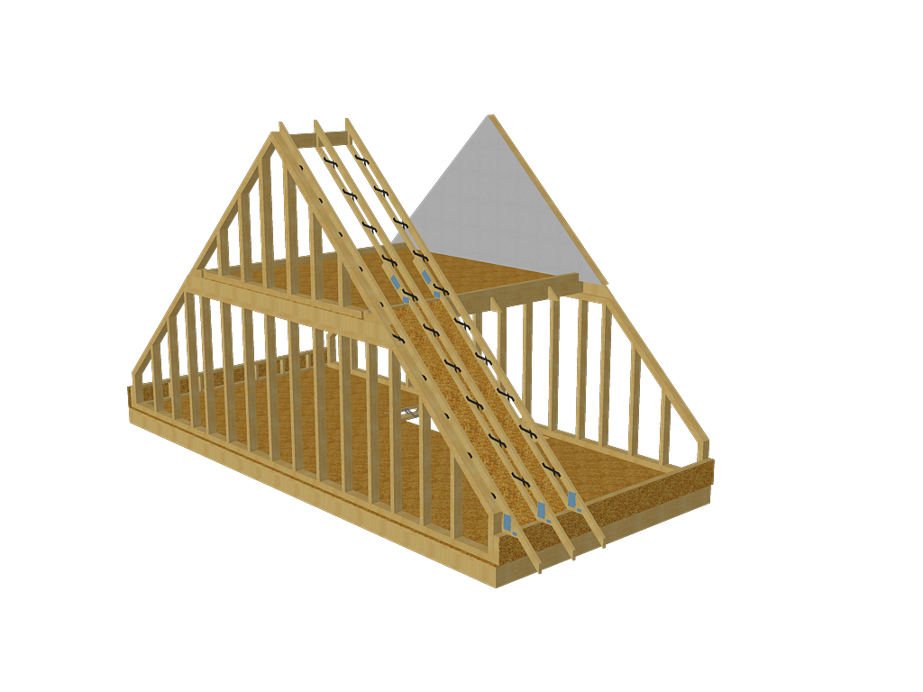
The MiTek Posi X-Rafter
Posi X-Rafter Panels clad with OSB in the habitable area are positioned, supported on the purlins and the dwarf wall.

Slide 14
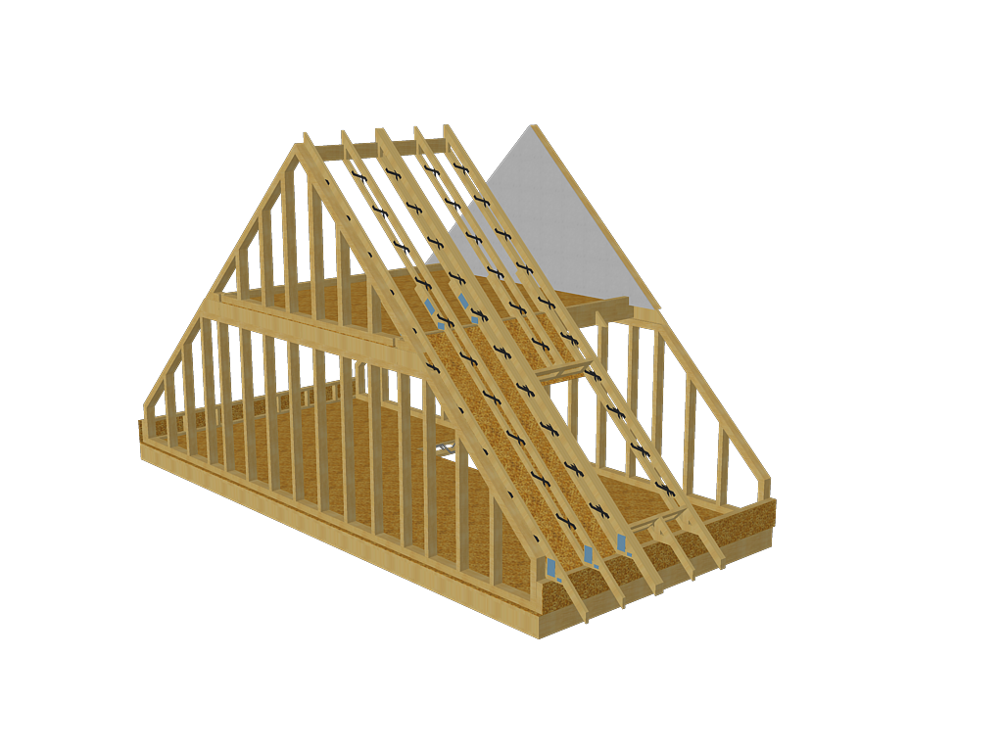
The MiTek Posi X-Rafter
Posi X-Rafter Panels clad with OSB in the habitable area are positioned, supported on the purlins and the dwarf wall.

Slide 15
The MiTek Posi X-Rafter
Posi X-Rafter panels are insulated, felted and battened at point of manufacture

Slide 16
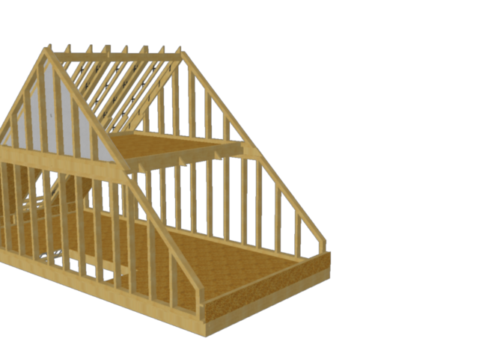
The MiTek Posi X-Rafter

Slide 17
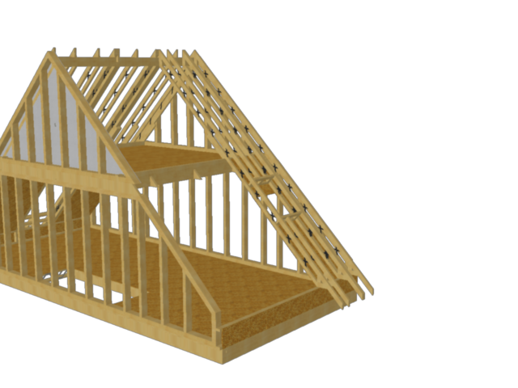
The MiTek Posi X-Rafter

Slide 18
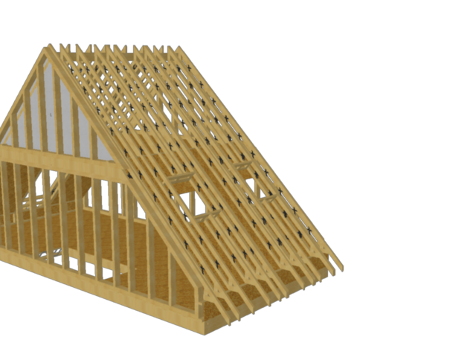
The MiTek Posi X-Rafter

Slide 19
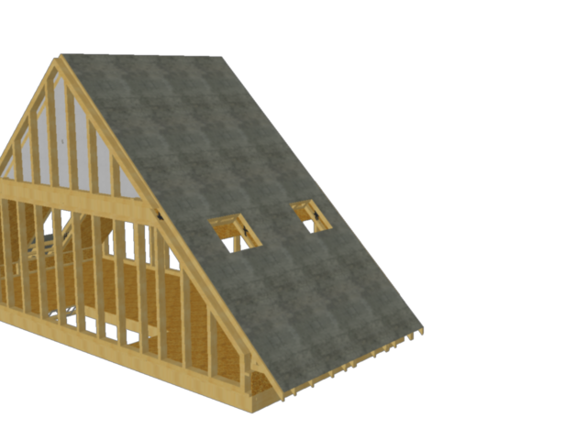
The MiTek Posi X-Rafter
Advantages over Alternative Systems
Light weight
Material savings
Less nailing
Stable during construction
Lower insulation costs
PATENT
APPLIED
FOR

